Slide 1
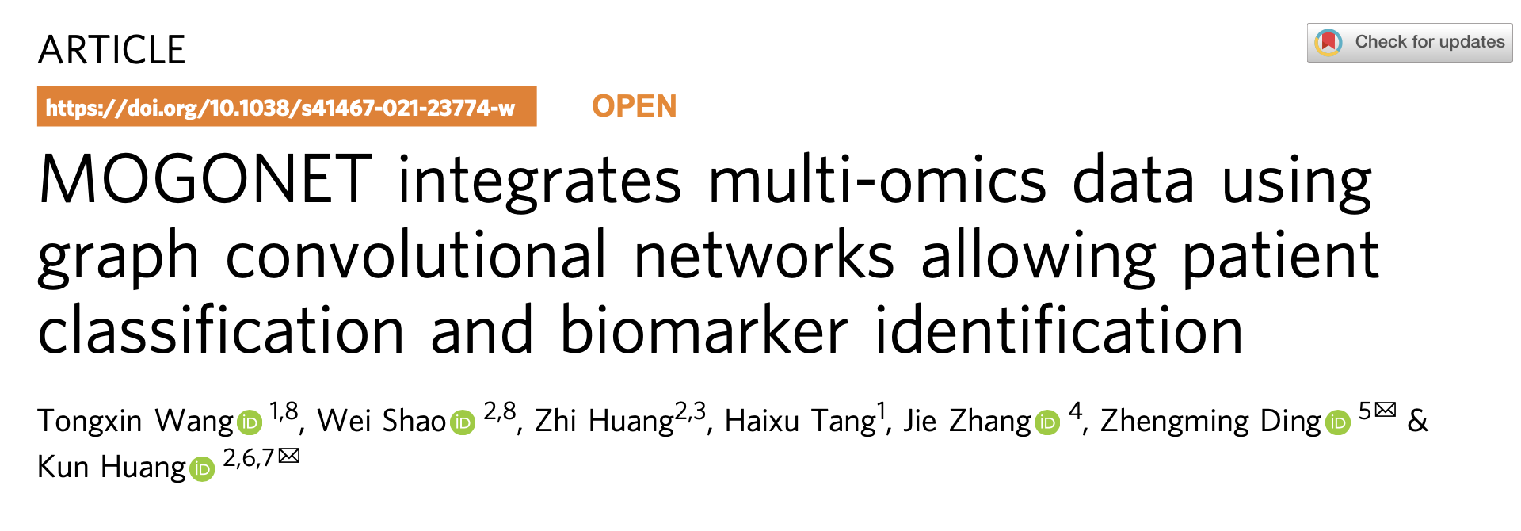





Presented by:
Md Mezbahul Islam (6334313)
Alif Moinul Alam (6370828)
Supervised by:
Dr. Ananda M Mondal

Slide 2
Outline
Introduction
Background Studies.
Problem Statement.
Objective
Methodology
Overall Illustration
Dataset Description
Result and Discussion
Conclusion and Future Direction

Slide 3
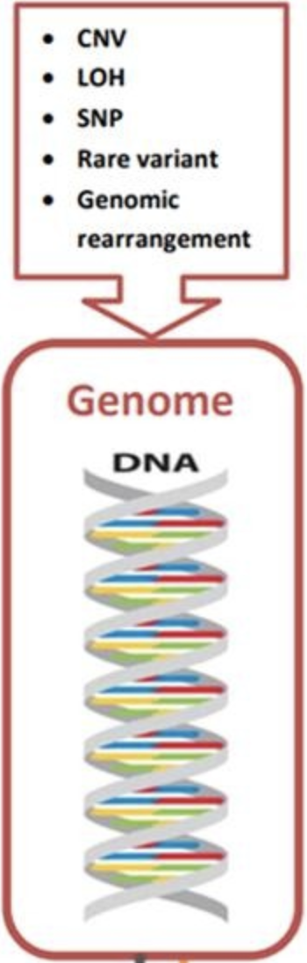
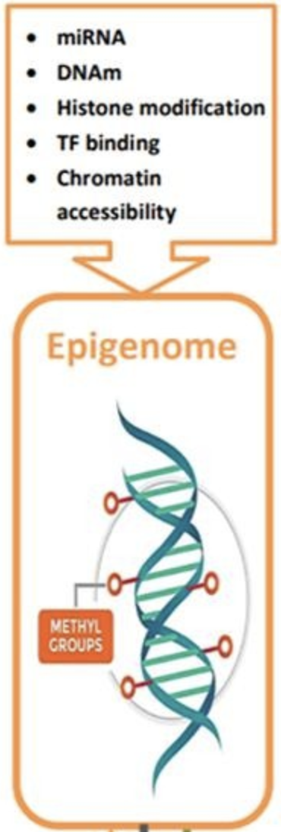
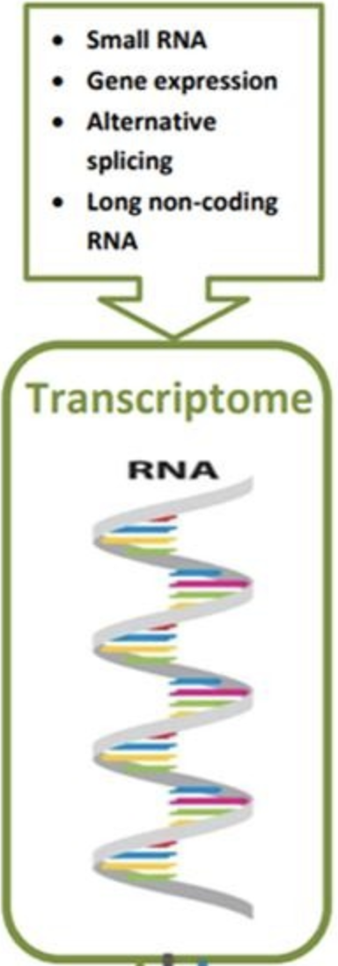
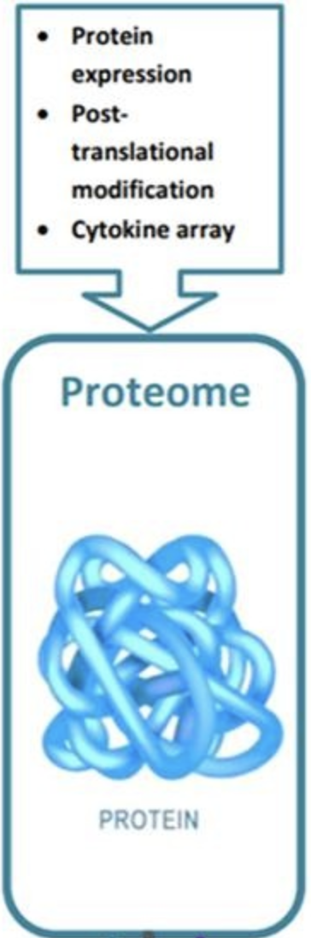
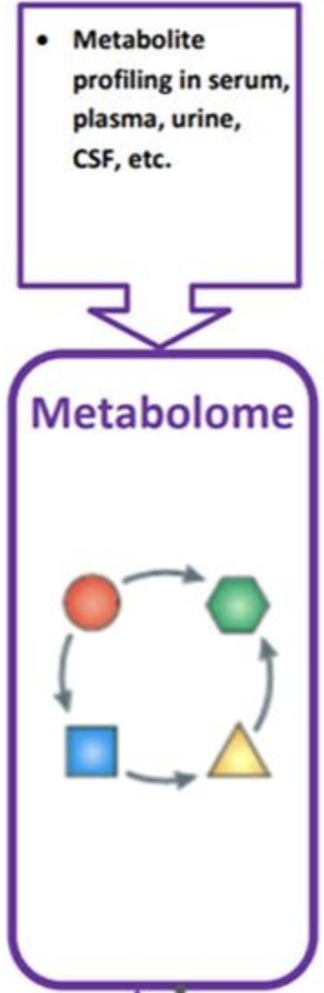
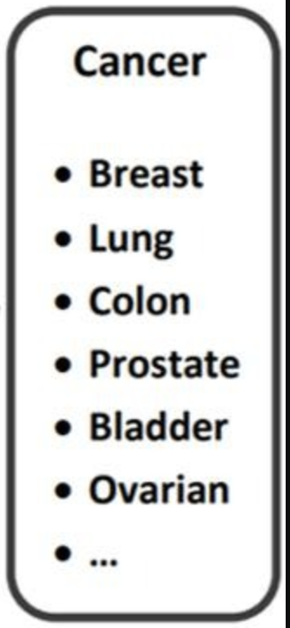
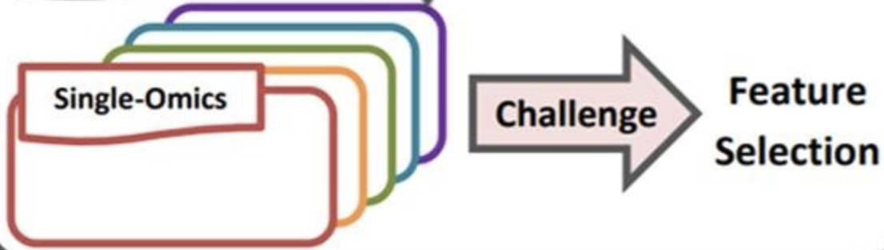
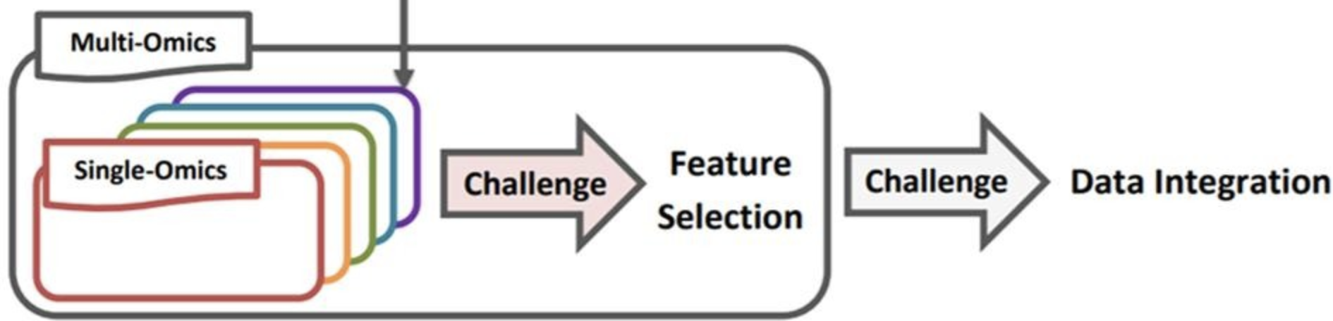
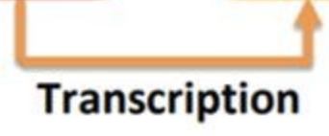
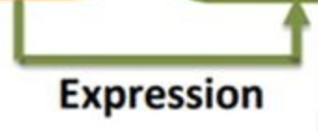
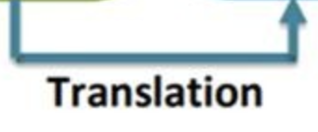
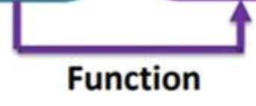
Introduction (Multi-omics and Integration)
CNV - Copy Number Variation
LOH - Loss of Heterozygosity
SNP - Single Nucleotide
Polymorphism
https://www.sciencedirect.com/science/article/pii/S1532046420300939

Slide 4
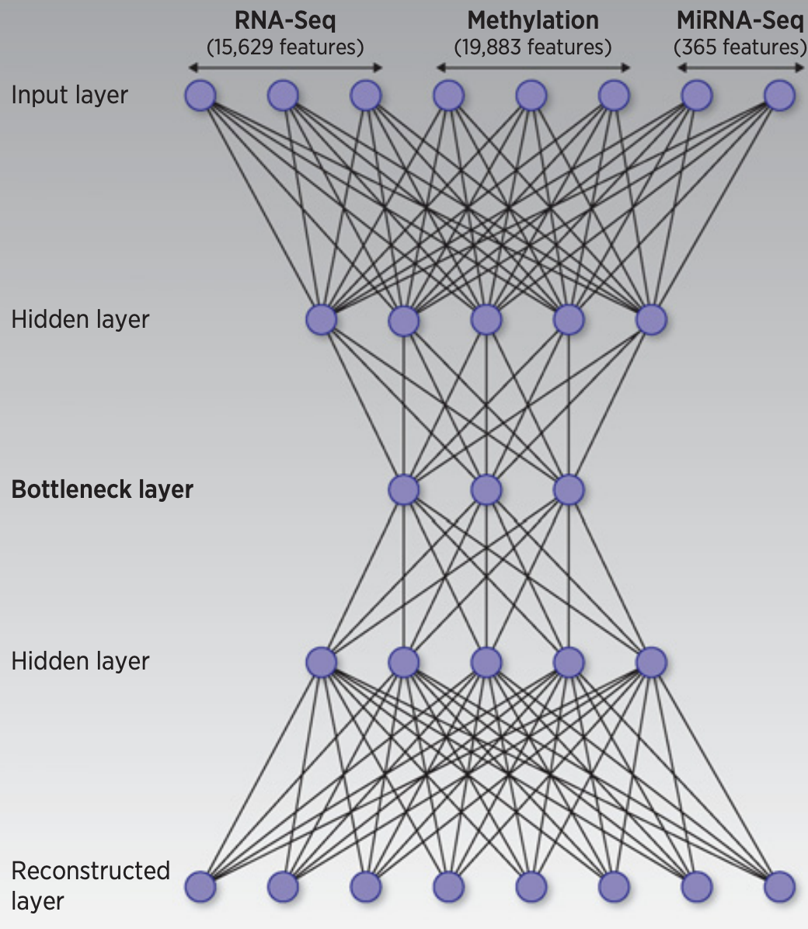
Introduction (Background Studies)
Most existing efforts focus on unsupervised multi-omics data integration without the additional information of sample labels.
There is an increasing interest in supervised multi-omics integration methods.
Feature concatenation-based strategies
Ensemble- based strategies.
Failed to consider the correlations among different omics data types.
Recently, multi-omics integration used deep neural networks (NN) because of
The high learning capability and
Flexibility of deep neural networks (NN)
Chaudhary, K., Poirion, O. B., Lu, L. & Garmire, L. X. Deep learning–based multi-omics integration robustly predicts survival in liver cancer. Clin. Cancer Res. 24, 1248–1259 (2018).
Notes:
A great number of methods have been proposed over the years to perform multi-omics data integration for various problems.
On the one hand, concatenation-based methods integrated different omics data types by directly concatenating the input data features to learn the classification model5. On the other hand, ensemble-based methods integrated the predictions from different classifiers, each trained on one type of omics data individually.

Slide 5
Introduction (Problem Statement)
These existing methods are based on fully connected networks.
They did not effectively exploit the correlations between samples through similarity networks.
Current deep learning-based methods often integrate different omics data at
The input space or
The learned feature space
Different types of omics data can also present unique characteristics at the high-level label space.
MOGONET unifies omics-specific learning with multi-omics integrative classification at the label space.
Utilizes graph convolutional networks (GCN).
Utilizes View Correlation Discovery Network (VCDN) to explore the cross-omics correlations.
Chaudhary, K., Poirion, O. B., Lu, L. & Garmire, L. X. Deep learning–based multi-omics integration robustly predicts survival in liver cancer. Clin. Cancer Res. 24, 1248–1259 (2018).
Notes:
A great number of methods have been proposed over the years to perform multi-omics data integration for various problems.
On the one hand, concatenation-based methods integrated different omics data types by directly concatenating the input data features to learn the classification model5. On the other hand, ensemble-based methods integrated the predictions from different classifiers, each trained on one type of omics data individually.

Slide 6
Objective
The first to utilize GCNs to perform effective class prediction on new samples.
Demonstrated the capabilities and versatility of MOGONET.
Wide range of biomedical classification applications.
Alzheimer’s disease patient classification.
Tumor grade classification in low-grade glioma (LGG).
Kidney cancer type classification.
Breast invasive carcinoma subtype classification.
Identify important omics signatures and biomarkers related to the investigated biomedical problems.

Slide 7
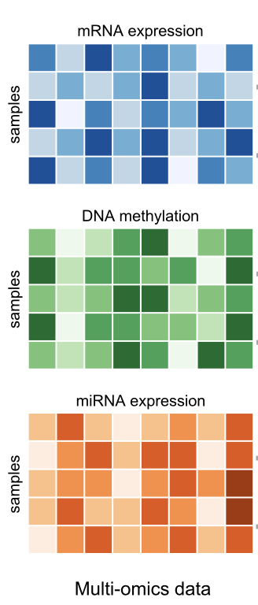
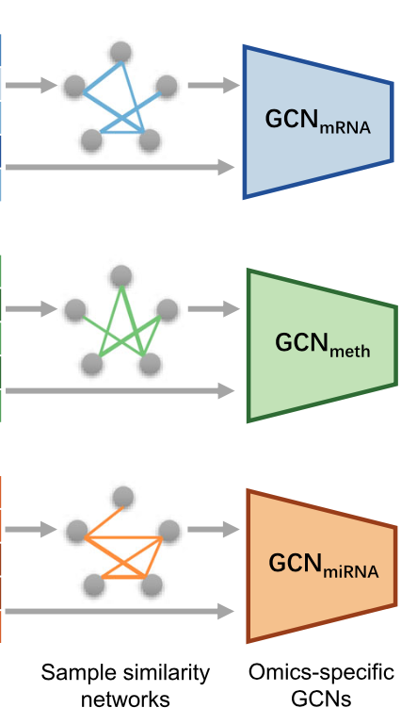
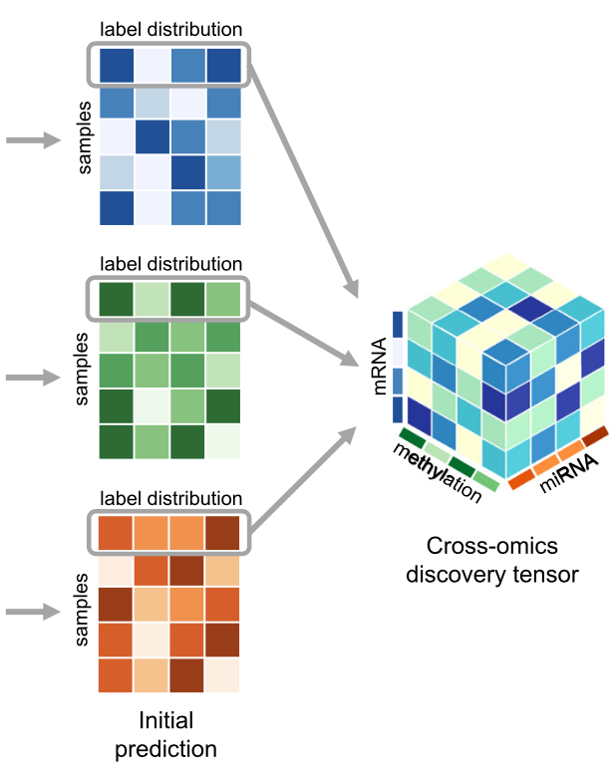
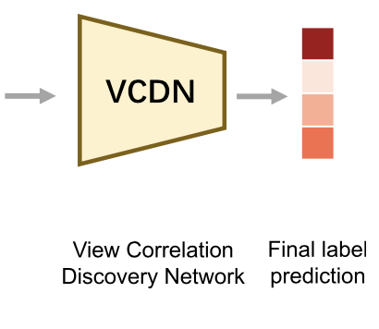
Methodology (Overall Illustration)
After preprocessing and
feature preselection
Cosine
similarity
Notes:
MOGONET combines GCN for multi-omics-specific learning and VCDN for multi-omics integration. For clear and concise illustration, an example of one sample is chosen to demonstrate the VCDN component for multi-omics integration. Preprocessing is first performed on each omics data type to remove noise and redundant features. Each omics-specific GCN is trained to perform class prediction using omics features and the corresponding sample similarity network generated from the omics data. The cross-omics discovery tensor is calculated from the initial predictions of omics-specific GCNs and forwarded to VCDN for final prediction. MOGONET is an end-to-end model and all networks are trained jointly.

Slide 8
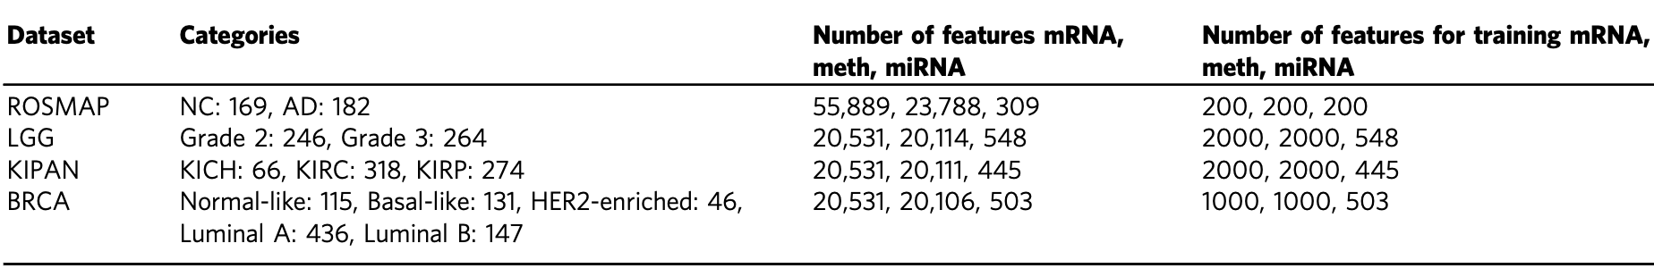
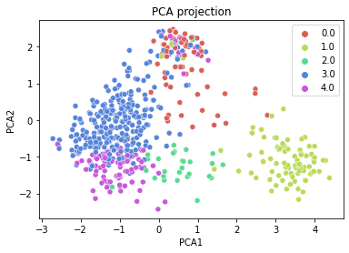
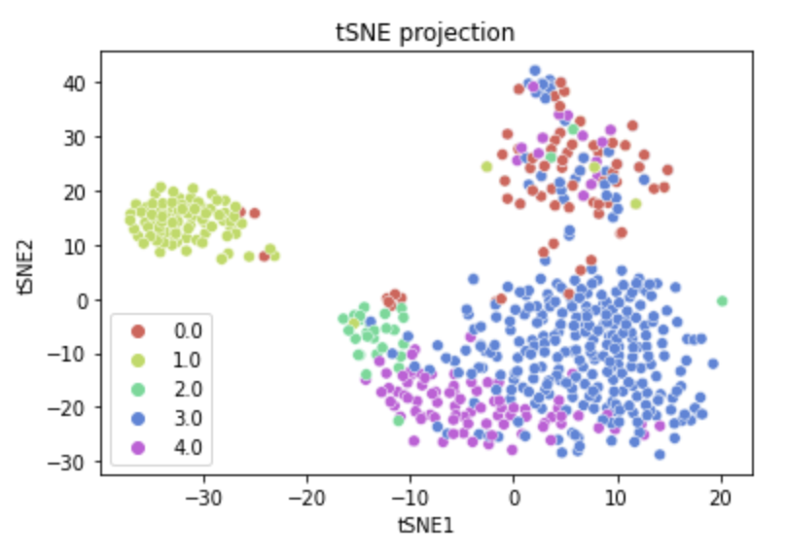
Methodology (Dataset description)
0: Normal-like
1: Basal-like
2: HER2-enriched
3: Luminal A
4: Luminal B
PCA and tSNE projection of BRCA dataset

Slide 9
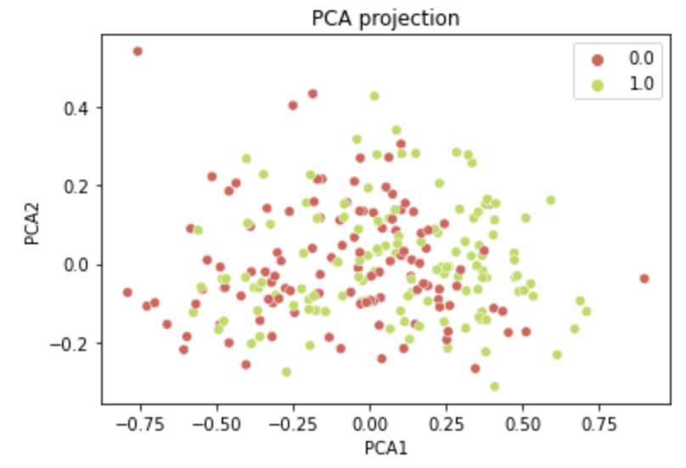
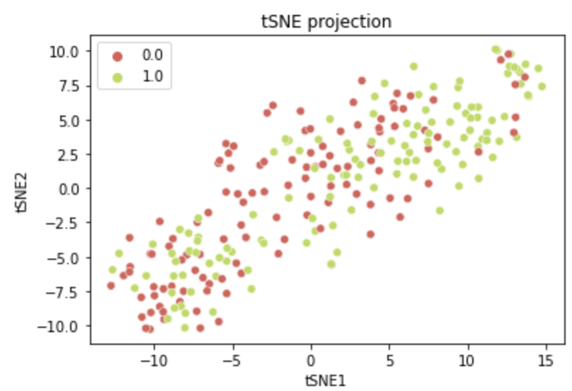
Methodology (Dataset description)
0: Normal Control. 1: Alzheimer's Disease
PCA and tSNE projection of ROSMAP dataset

Slide 10


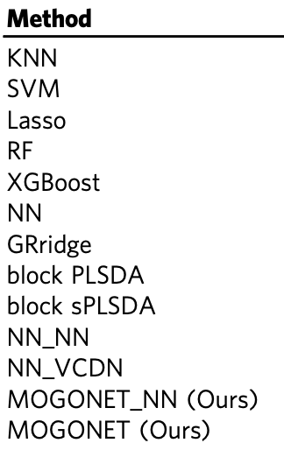
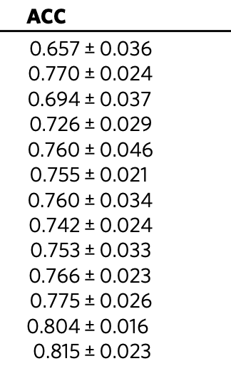
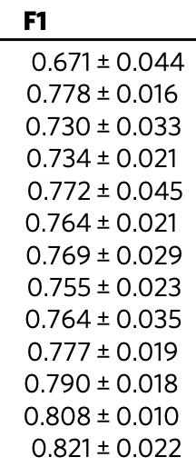
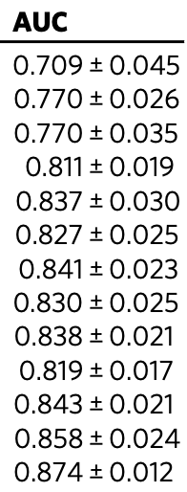
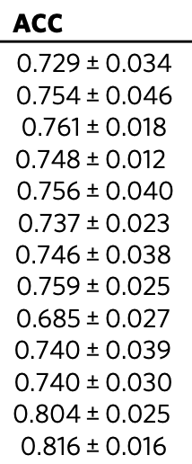
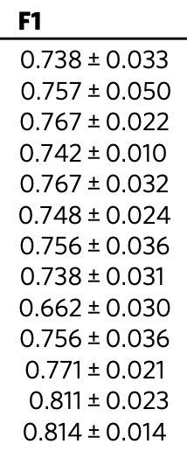
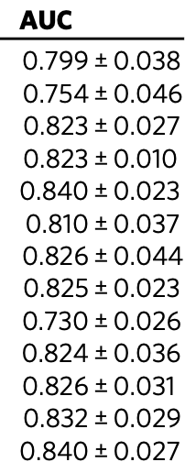
Result and Discussion

Slide 11
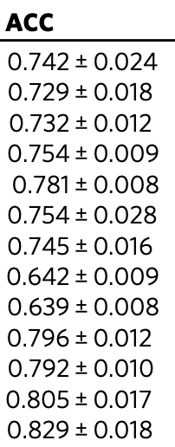
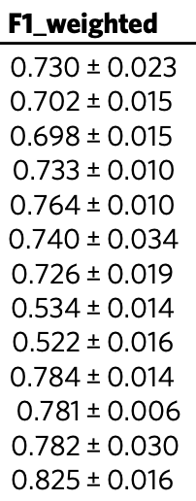
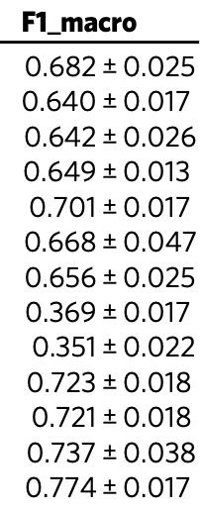
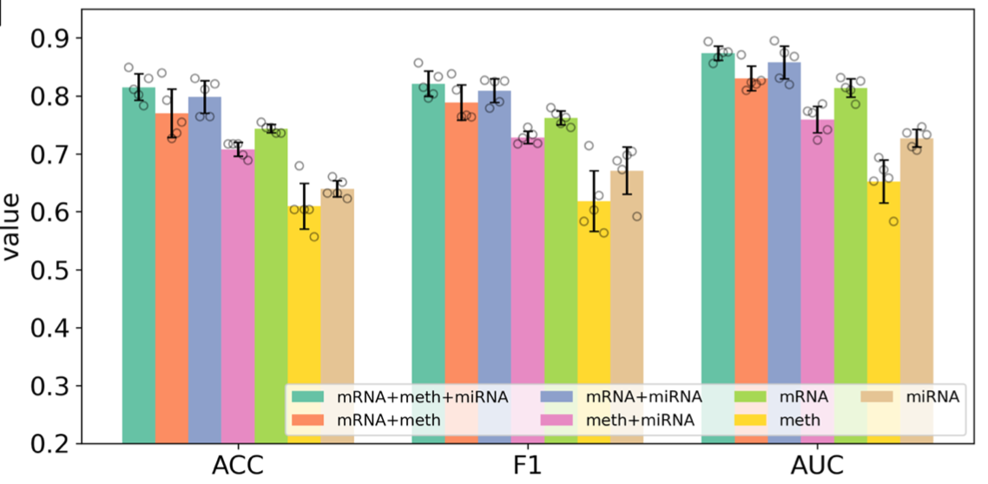
Result and Discussion
Performance comparison of multi-omics data classification via MOGONET and single-omics data classification via GCN
ROSMAP dataset

Slide 12
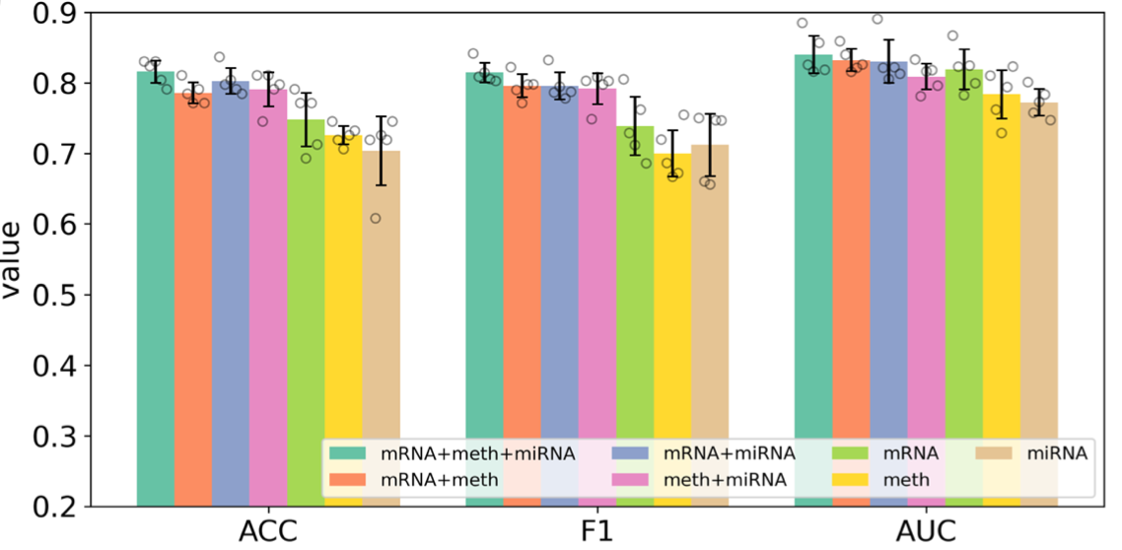
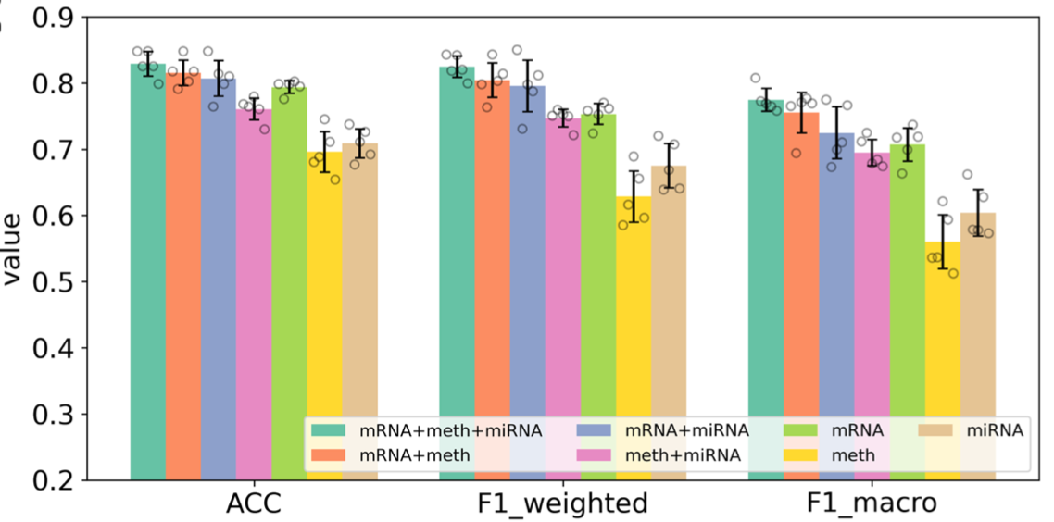
Result and Discussion
Performance comparison of multi-omics data classification via MOGONET and single-omics data classification via GCN
LGG dataset
BRCA dataset

Slide 13
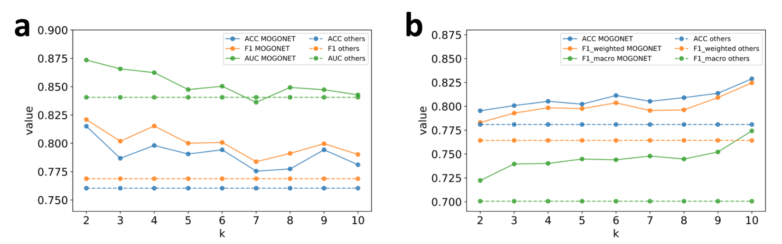
Result and Discussion
Performance of MOGONET under different values of hyper-parameter k
a. Results of the ROSMAP dataset. b. Results of the BRCA dataset.
Dashed lines - existing multi-omics integration methods
GRridge for ROSMAP
XGBoost for BRCA.

Slide 14
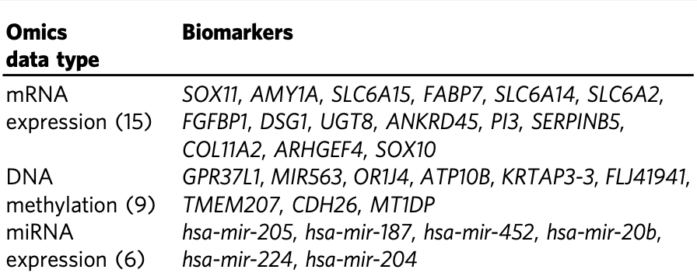
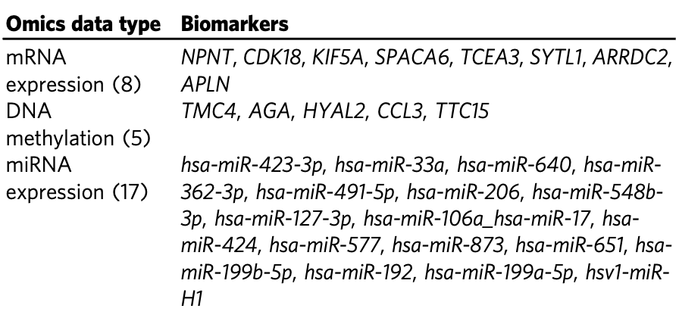
Result and Discussion
Important omics biomarkers identified by MOGONET in the ROSMAP dataset (left) and in the BRCA dataset (right).

Slide 15
Conclusion
Omics technology and personalized medicine are proliferating.
Labeled omics datasets with detailed annotations are becoming available.
MOGONET
Supervised multi-omics integration method
Deep multi-view learning for biomedical classification tasks.
Utilized GCNs for omics-specific learning.
VCDN for multi-omics integration at the high-level label space.
It is an innovative deep learning-based multi-omics classification algorithm with superior performance and good interpretability.

Slide 16
Future Direction
The multi- omics integration component can be extended to accommodate different or more types of data.
The label distribution generated by each omic-specific GCN can be integrated by
either direct concatenation as in MOGO- NET_NN or
constructing a cm-dimensional cross-omics discovery vector with the similar fashion as in MOGONET.

Slide 17
Thank you

